Slide 1

PORTFOLIO CASE STUDY
BioShock: What Players Value
A data-driven analysis of the trilogy's reception, and how it can shape the revival
Savion Barron| September 2026
github.com/saviongb/Bioshock-Revival-Analysis

Slide 2
Executive Summary
SITUATION
Thirteen years after Infinite, BioShock’s next release can draw on 85,395 player reviews across the franchise to guide development direction
WHAT THE REVIEWS SHOW
Narrative is the heart of BioShock
Technical performance dominates negative reviews
Infinite leaned into narrative, away from combat
24.6 / 23.5 / 40.4
60.5 / 75.3 / 12.0
8.0 / 7.9 / 23.6
% of reviews mentioning narrative
% of negative reviews mentioning technical
% of negative reviews mentioning combat
B1
B2
INF
B1
B2
INF
B1
B2
INF
Reviewers recognize storytelling elements across the franchise. Narrative is the only theme mentioned in at least 20% of reviews for each title
Negative reviews of the B1 and B2 mentioned technical performance at significantly higher rates than infinite
Nearly ¼ of the negative reviews of Infinite mentioned combat elements with pacing following a similar trend
RECOMMENDATION
The next BioShock should protect its narrative driven identity while not losing sight of what differentiates it from other titles, an engaging combat system. Additionally, delivering a polished product will be key for launch success.
Base: 85,395 English Steam reviews. Themes detected by keyword dictionaries written before analysis and validated against hand coded sample. See scope and definitions. Method on slide 3.

Slide 3
State of the next BioShock
WHAT IS KNOWN
QUESTIONS THAT IMPACT DEVELOPMENT
1
2K announced Cloud Chamber in 2019, the studio that will develop the next BioShock. Q3 FY2020 materials noted that the next installment would be in development for several years
1
What elements of past BioShock titles should 2K protect/retain?
2
Leadership change and reset. Take-Two Q2 FY2026 earnings call confirmed Rod Fergusson as head of BioShock franchise and now leading Cloud Chamber. Slatoff (2K President) on record stating that “the next BioShock is going to take the franchise to the next level”.
2
Where was negative reception of the franchise directed?
3
Has the 13-year dormancy changed perception or interest in the franchise?
3
CEO commented on the difficulty of development. Zelnick expresses his disappointment with the wait, explaining that resources were committed to creative directions that led nowhere.
Sources: Take-Two investor materials (Q3 FY2020, Q2 FY2026, Q1 FY2027) and Game File, May 2026. Full citations in appendix.

Slide 4
Method and instrument
85,395
9
4
72
English reviews across BioShock 1 Remastered, BioShock 2 Remastered and Infinite from Steam’s public API with python
Theme dictionaries ran against all reviews in pandas to identify which themes are mentioned (e.g. see appendix for full dictionaries).
measures per theme: frequency, verdict split, review era, playtime groups
reviews hand-coded to measure precision and recall for every theme
Registered first
Full impressions and hypothesis were written after all three BioShock playthroughs were completed then committed to github before data analysis. Theme dictionaries were also committed before any analysis to reduce curve fitting.
https://github.com/saviongb/Bioshock-Revival-Analysis

Slide 5
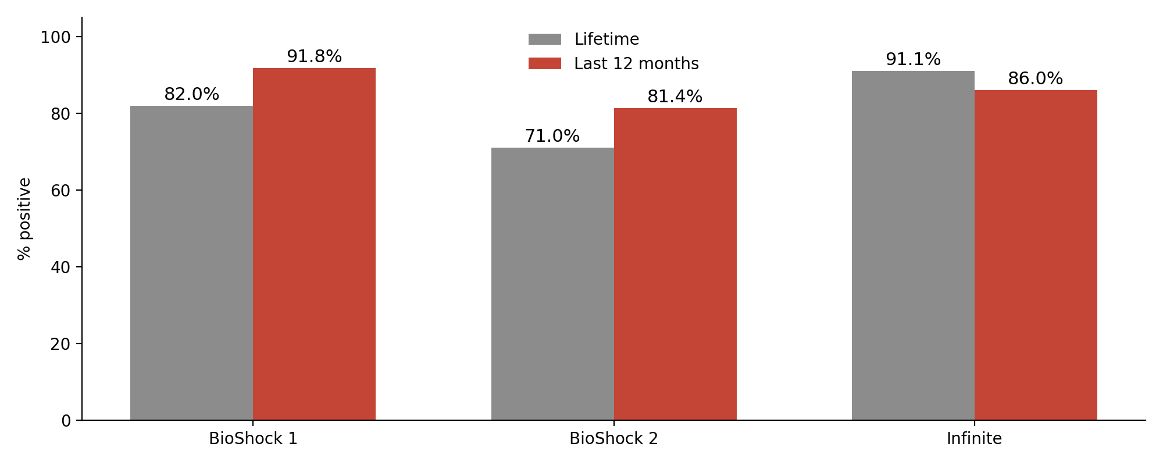
A decade later, the remasters review better than their lifetime average
REVIEWS IN THE LAST 12 MONTHS
2,346
BioShock Remastered
1,290
BioShock 2 Remastered
1,577
Infinite
After nearly 2 decades since the original release of BioShock 1 and a decade after the remasters, reviewers still respond positively to the BioShock blueprint.
Base: % positive within each group, lifetime and the 12 months to July 26, 2026.

Slide 6
Narrative is the only theme mentioned in at least 20% of reviews across all BioShock titles
BioShock 1
BioShock 2
Infinite
24.6%
23.5%
40.4%
2nd highest % across 9 tested
2nd highest % across 9 tested
Highest % across 9 tested
Technical performance is mentioned in a higher % of reviews for BioShock 1 (25.0%) and BioShock 2 (40.3%), although reflects the port rather than game design.
Base: % of each title’s reviews mentioning narrative (B1: 26,155) (B2: 12,008) (Infinite: 47,232)

Slide 7
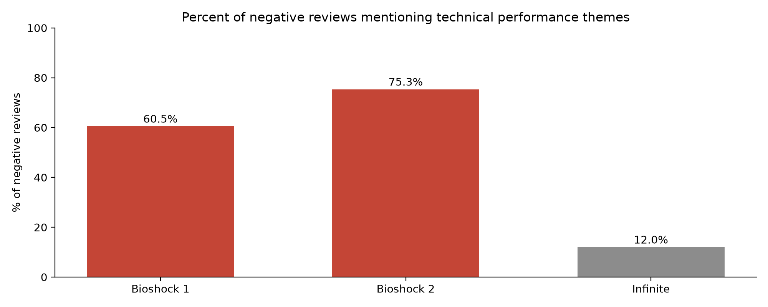
BioShock 1 & 2 reviews mention technical performance in negative reviews at a higher rate than Infinite
Base: % of each game’s negative reviews (B1 4,698, B2 3,480, Infinite 4,182)
Technical detection recall was 58%, true mention rates likely higher than shown

Slide 8
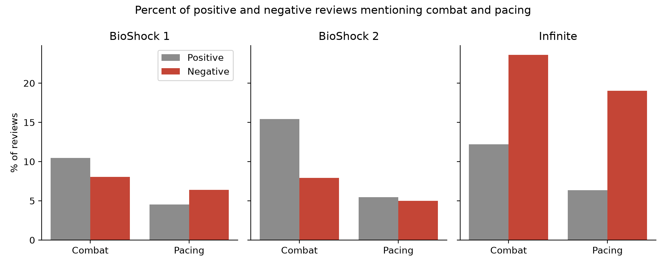
Combat and pacing mentioned in a higher percent of Infinite’s negative reviews compared to remasters
Base: % of each game’s positive reviews and % of its negative reviews (B1 21,457 / 4,698) (B2 8,528 / 3,480) (Infinite 43,050 / 4,182)
Combat and pacing detection was weak (recall 57% and 40%)

Slide 9
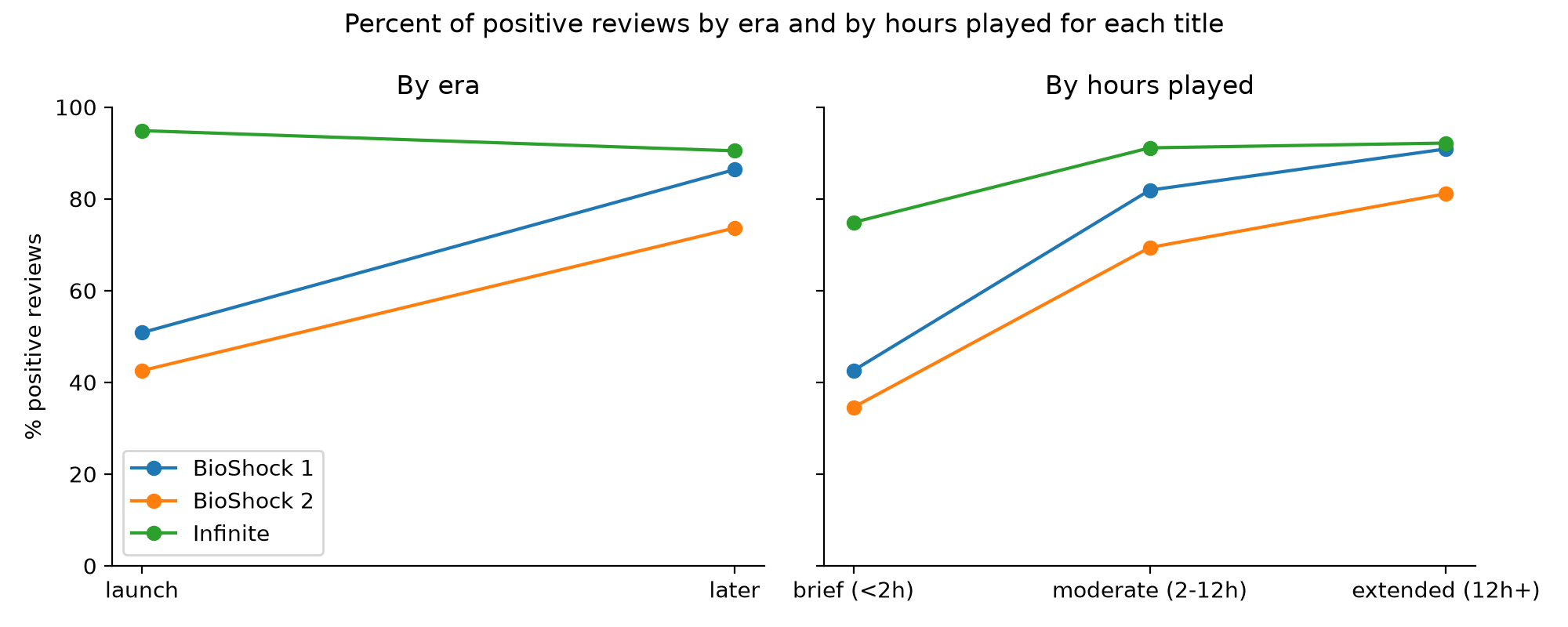
Positive reviews skew higher in later eras and as playtime increased, except in Infinite’s later era decline
Base: % of each game's positive reviews within each era and playtime group (n varies)
Era and playtime groups represent different reviewers, not how individual perception changes over time

Slide 10
Hypothesis results
Prediction | Evidence | Result
BioShock’s positive reviews emphasize narrative and atmosphere | Narrative: + 27.6% / - 10.6% Atmosphere: + 5.6% / - 1.9% | Partially confirmed
BioShock’s negative reviews emphasize pacing and combat | Pacing: + 4.5% / - 6.4% Combat: + 10.5% / - 8% | Not confirmed
BioShock 2’s positive reviews will emphasize combat mechanics | Combat: + 15.4% / - 7.9% | Partially confirmed
BioShock 2’s negative reviews will emphasize storytelling elements and technical stability | Narrative: +28.3% / - 11.9% Technical: + 26% / - 75.3% | Partially confirmed
Infinites positive reviews will emphasize storytelling elements | Narrative: + 40.6% / - 38.4% negative | Partially confirmed
Infinites negative reviews will emphasize mechanical aspects | Combat: + 12.2% / - 23.6% negative | Confirmed
Predictions were committed before data was examined and any theme dictionaries were set

Slide 11
What the findings suggest for the next BioShock
01
02
03
Narrative is the essence of BioShock
Stability can overshadow design
Infinite changed course on Combat
Players recognize and discuss the rich narrative that has become the centerpiece of BioShock's identity. These elements should be protected in BioShock 4 development
Technical performance can negatively influence a player's perception and overshadow appreciation for design. Prioritize technical performance and functionality testing in BioShock 4
Infinite was right to prioritize narrative, although players discussed the combat more often in negative reviews than previous titles. The next BioShock should address this imbalance and innovate upon the combat style players appreciated
Takeaway
BioShock 4 must strike a balance between aspects it has proven it can deliver
BioShock 4 should continue to protect its ambitious narrative driven identity while not losing sight of what makes the series immersive (combat). Delivering a polished product will be key to its initial success.

Slide 12
DOOM (2016) – When the revival goes right
12 years
Doom (2016)
95% positive 84,839 reviews
Doom 3 (2004)
13 years
BioShock Infinite (2013)
BioShock 4? (TBD)
95%
84,839
The 2016 DOOM release serves as an example of the success that can follow from reviving an acclaimed title/series
DOOM (2016) reviews positive
English steam reviews
Base: DOOM (2016) data from steam store summary, accessed [9/3/2026]. Figures only intended to provide an example of a successful revival.

Slide 13
Dishonored 2 (2016) – Acclaim alone cannot carry a sequel
Even with the most beloved titles, a sequel cannot ride on acclaim alone. Dishonored 2 has roughly twice as many negative English steam reviews with half the total reviews.
97%
88%
Dishonored (2012)
Dishonored 2 (2016)
Base: Dishonored (2012) and Dishonored 2 (2016) data from steam store summary, accessed [9/3/2026]. Figures only intended to provide an example of a less successful revival.

Slide 14
What this analysis cannot tell you
Attention, not approval
Every theme undercounts
The analysis used keyword identification to count specific themes across positive and negative reviews. This tells us what reviewers talk about, not their approval/disapproval.
Validation recall ranged from 93% for narrative to 25% for visual and audio. Comparing the same theme across each title is consistent, although cross-theme comparisons are inaccurate.
Remasters, English, Steam
No causal claims
BioShock 1 and 2 are remastered releases, Infinite is original. All data is sourced from English Steam reviews only
The analysis best suited for understanding what BioShock reviewers discuss, rather than making concrete decisions on design.
Full methodology, theme dictionaries and validation results are in the appendix and public GitHub

Slide 15
Appendix - Theme dictionaries
Theme | Keywords
Narrative | twist, would you kindly, betrayal, obedience, protector, flashback, redemption, timeline, multiverse, realities, constants, genes, genetic engineering, gene altering, autonomy, agency, conditioned, kidnapping, storytelling, narrative, writing, dialogue, story, plot, ending
Setting | rapture, underwater, city, art deco, retro, theatre, columbia, floating, sky, americana, steampunk, utopia, environment, architecture, dystopian, ocean, ruins, aesthetic, lighthouse, pavilion, arcadia, prometheus, amusements
Atmosphere | horror, eerie, scary, tense, immersive, uncomfortable, disturbing, mystery, dread, claustrophobic, twisted, unsettling
Characters | jack, ryan, atlas, fontaine, tenenbaum, cohen, little sister, daddies, daddy, splicer, delta, eleanor, lamb, sofia, sinclair, grace, big sister, poole, booker, elizabeth, comstock, songbird, twins, daisy, turrets, mosquito, zeppelin, barrage, handyman, fireman, zealot, motorized patriot, siren, boy of silence, lutece, suchong
Combat | plasmids, combat, movement, quantum tear, weapons, gunplay, shooting, vigors, guns, wrench, research camera, drill, rivet, hack, sky-hook, adam, eve, tonics, difficulty
Ideology | capitalism, greed, individualism, free will, wealth disparity, exploitation, slavery, selfishness, political, religious, religion, oppression, collectivism, utilitarianism, exceptionalism, communism, police state, ayn rand, authoritarian, right wing, morality, objectivism, racism, nationalism
Visual/Audio | lighting, audio, graphics, music, voice acting, sound design, style, soundtrack
Technical | crash, stutter, performance, port, patch, fov, mouse, bugs, optimization, fps, controls, resolution, freezing, freeze, glitching, glitch, glitches, crashes, crashed, crashing, laggy
Pacing | repetitive, short, long, boring, tedious, replay ability, backtrack, drags, filler, padding

Slide 16
Appendix - Validation Results
Theme | Precision | Recall
Narrative | 0.87 | 0.93
Setting | .80 | .50
Atmosphere | 1.0 | 0.30
Characters | .8 | .67
Combat | 1.0 | .57
Ideology | .50 | .50
Visual/audio | .75 | .25
Technical | .91 | .58
Pacing | .50 | .40

Slide 17
Appendix – data and comparison sources
Game | English Steam Reviews | % positive | Source | Accessed
BioShock Remastered | 26,155 | 82.0 | Steam review API (notebook 1) | July 26, 2026
BioShock 2 | 12,008 | 71.0 | Steam review API (notebook 1) | July 26, 2026
BioShock Infinite | 47,232 | 91.1 | Steam review API (notebook 1) | July 26, 2026
Doom (2016) | 84,839 | 95.0 | Steam store review summary | September 3, 2026
Dishonored (2012) | 39,664 | 97.0 | Steam store review summary | September 3, 2026
Dishonored 2 (2016) | 19,817 | 88.0 | Steam store review summary | September 3, 2026

Slide 18
Appendix - repository, sources, and AI use
REPOSITORY
SOURCES CITED
github.com/saviongb/Bioshock-Revival-Analysis Impressions, Notebooks, Theme dictionaries, Predictions, and Commit history.
Take-Two Q3 FY2020 earnings
Feb 6, 2020 — ir.take2games.com/node/26586/pdf
Take-Two Q2 FY2026 earnings call
AI USE
Nov 6, 2025 — https://www.roic.ai/quote/TTWO:UW/transcripts/2026-year/2-quarter
Claude was used as a programming guide and brainstorming tool, all analytical decisions, hand-coding, and findings are my own.
Take-Two Q1 FY2027 results
Aug 7, 2026 — https://www.take2games.com/ir
Game File, Stephen Totilo
May 2026 — https://www.gamefile.news/p/bioshock-gta-nfl-civ7-take-two-strauss-zelnick

Slide 19
Appendix - scope and definitions
CORPUS
REVIEW ERA
85,395 English reviews pulled from Steam's public review API on July 26, 2026. BioShock Remastered 26,155, BioShock 2 Remastered 12,008, BioShock Infinite 47,232.
Launch era covers the first 12 months after each title's Steam release; later era covers everything after. Era groups are different reviewers, not the same reviewers over time.
TITLES
PLAYTIME BANDS
BioShock 1 and 2 are the 2016 remastered releases, not the original 2007 and 2010 versions. Infinite is the original release.
Brief under 2 hours, moderate 2 to 12 hours, extended 12 hours or more, hours recorded at the time of review.
VERDICT
RECENT DATA (SLIDE 4)
Positive or negative as recorded by Steam's thumbs up / thumbs down, not from review text.
Reviews written in the 12 months to July 26, 2026. While still a finding, not a major component of the review data analysis. Intended to provide an idea of how players respond to the title currently.

